Slide 1
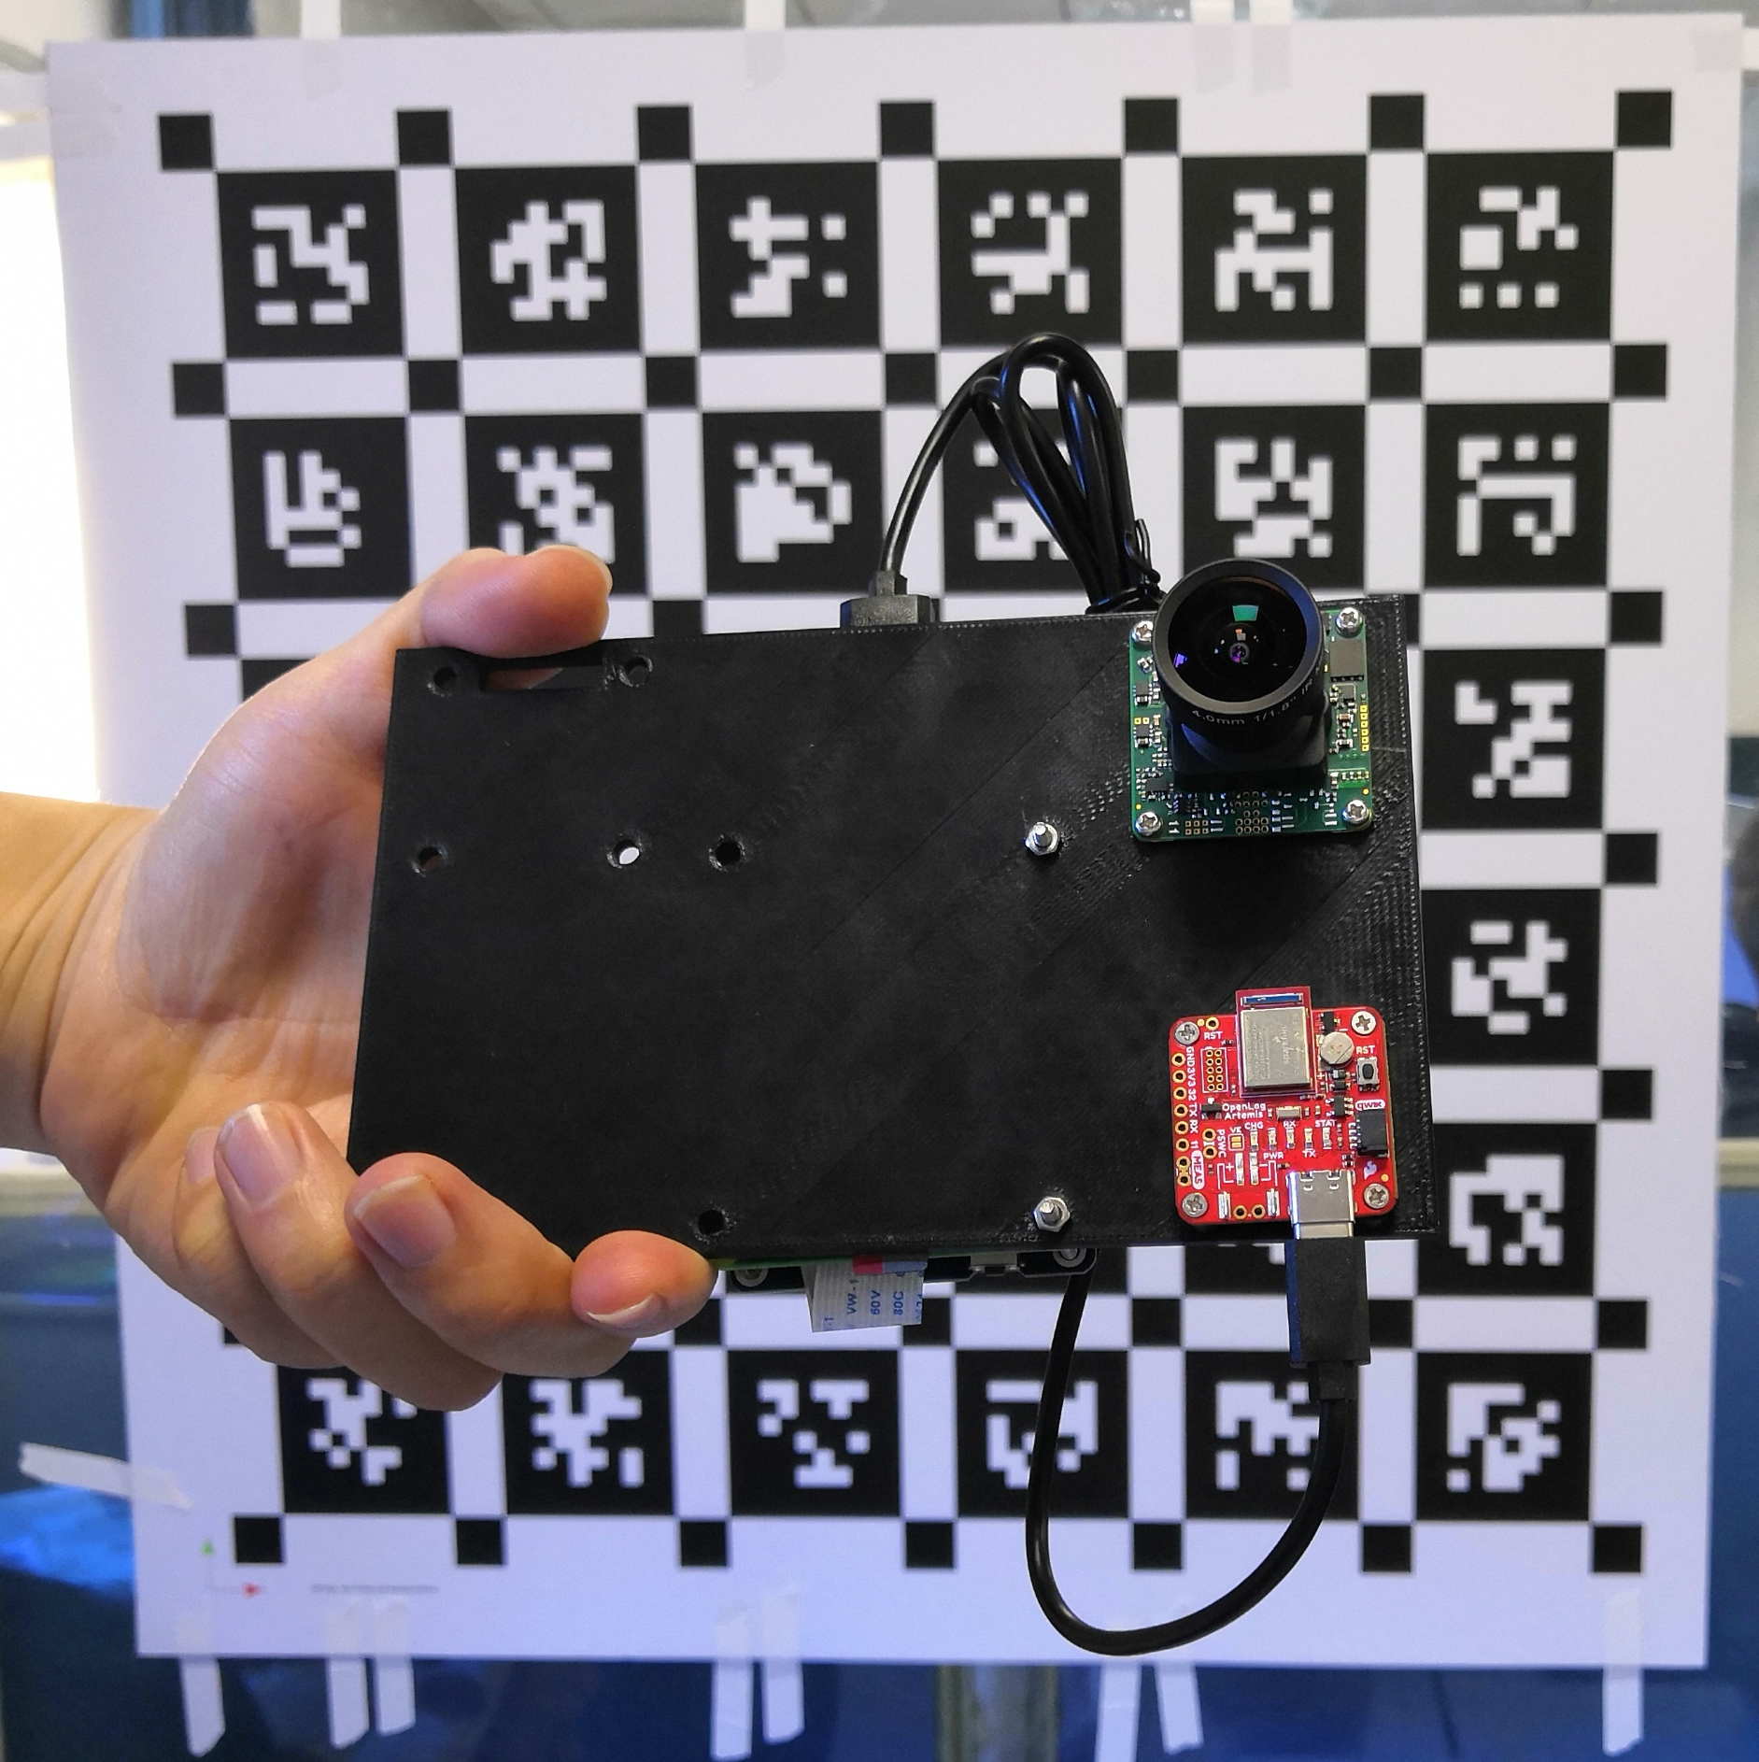
Ueye artemis IMG_20210314_143753
https://learn.sparkfun.com/tutorials/openlog-artemis-hookup-guide/hardware-overview

Slide 2
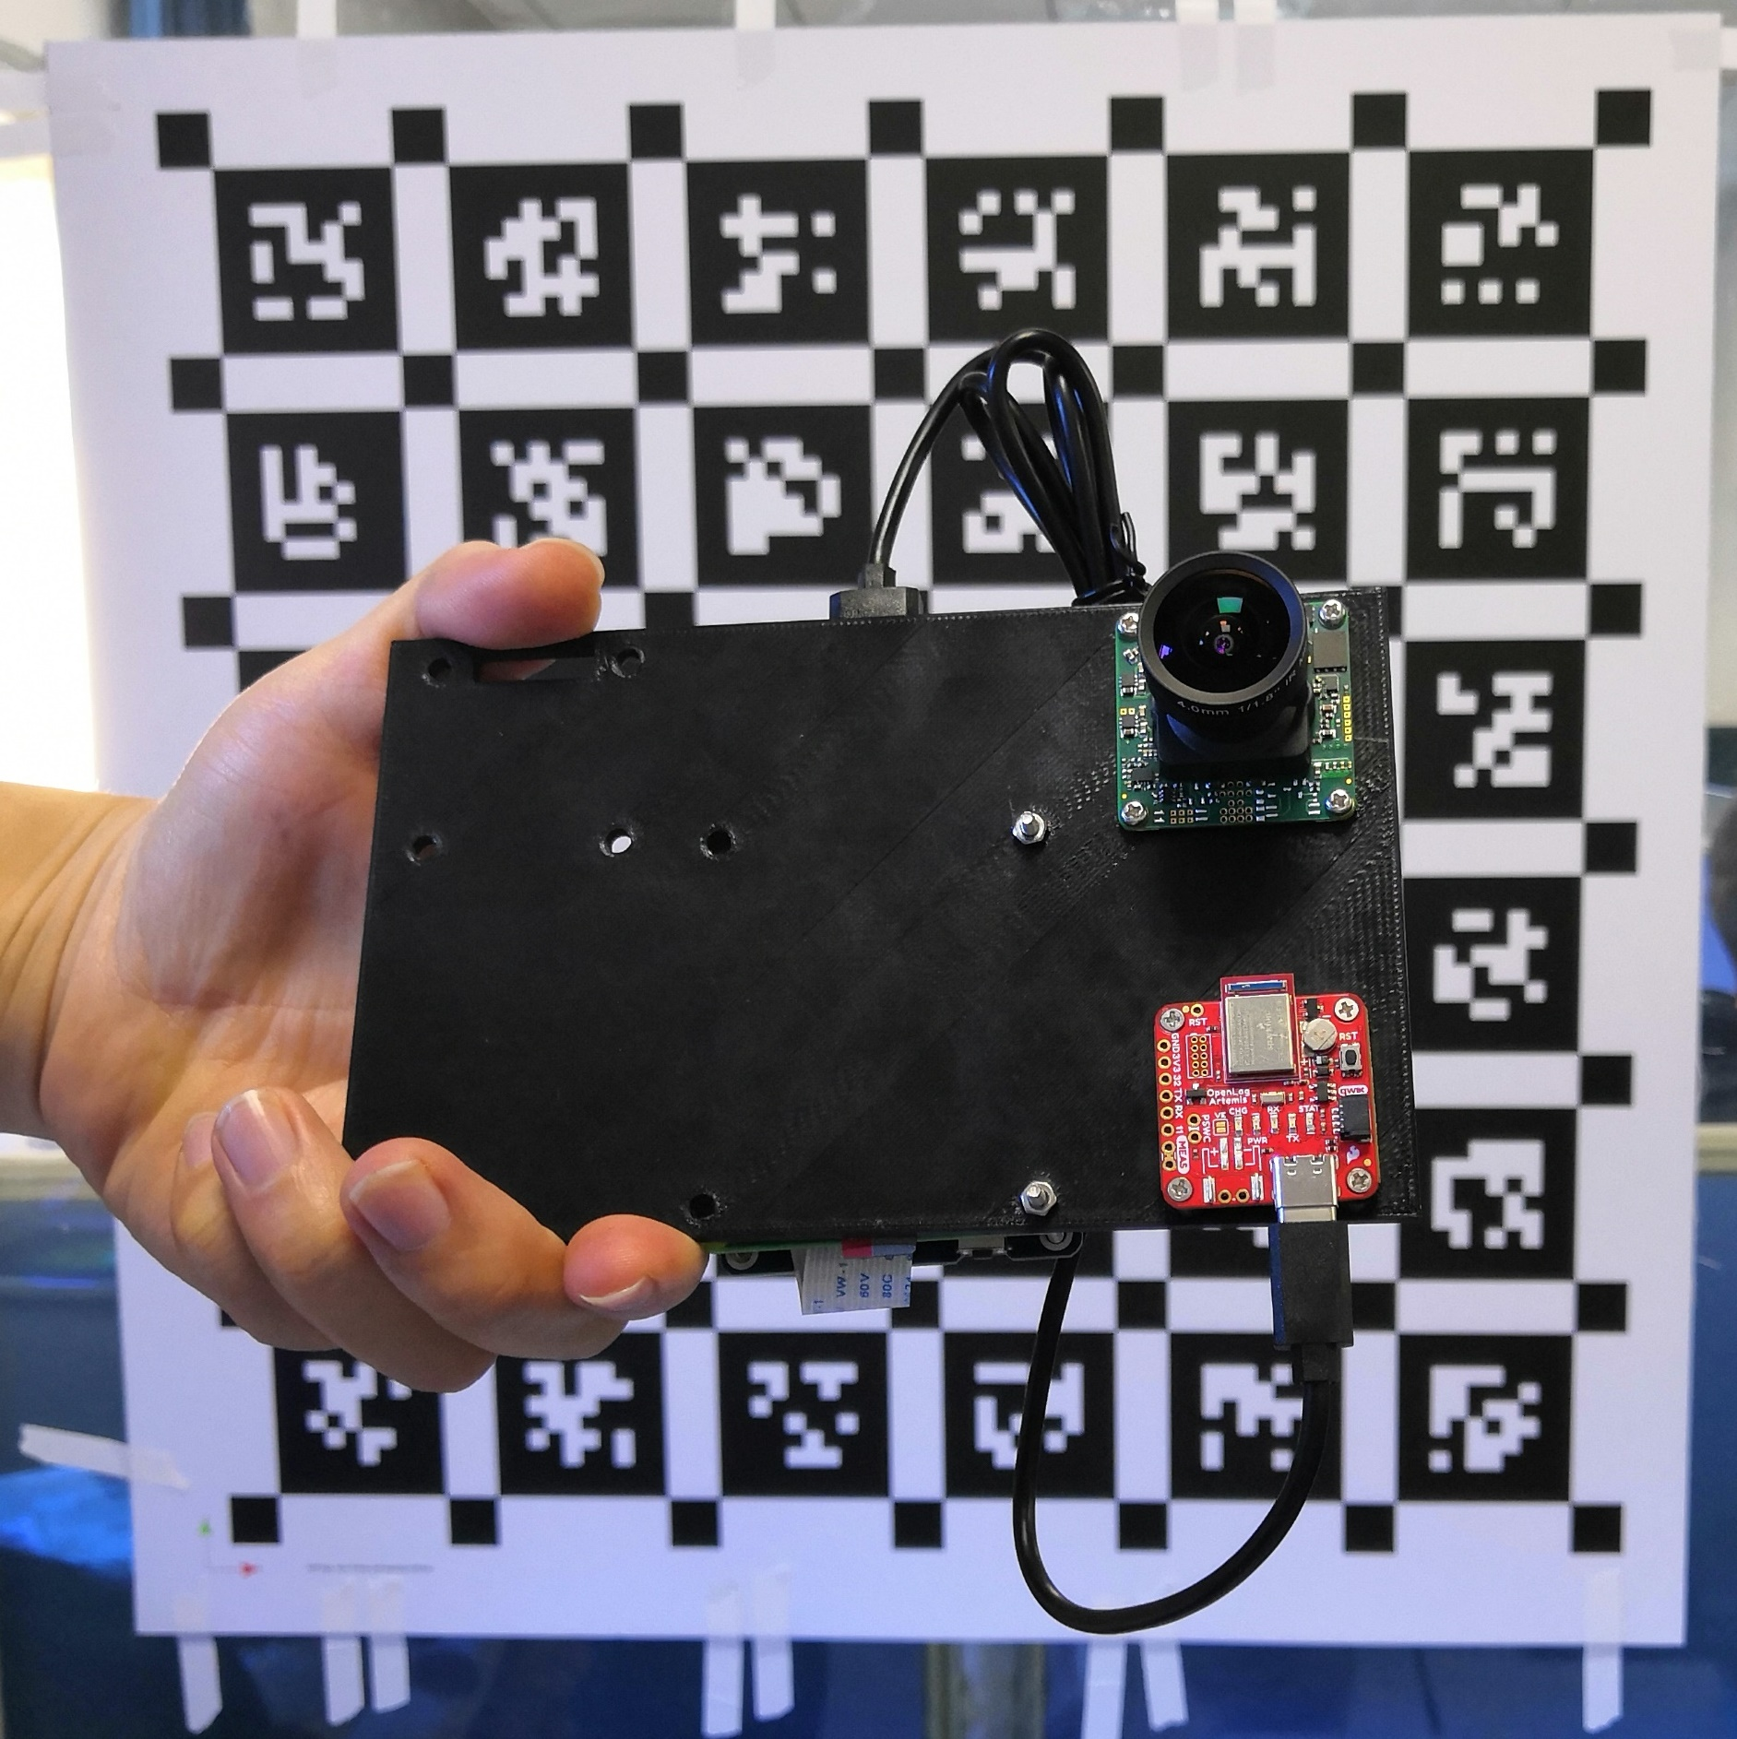
IMG_20210314_143753 compressed
https://learn.sparkfun.com/tutorials/openlog-artemis-hookup-guide/hardware-overview

Slide 3
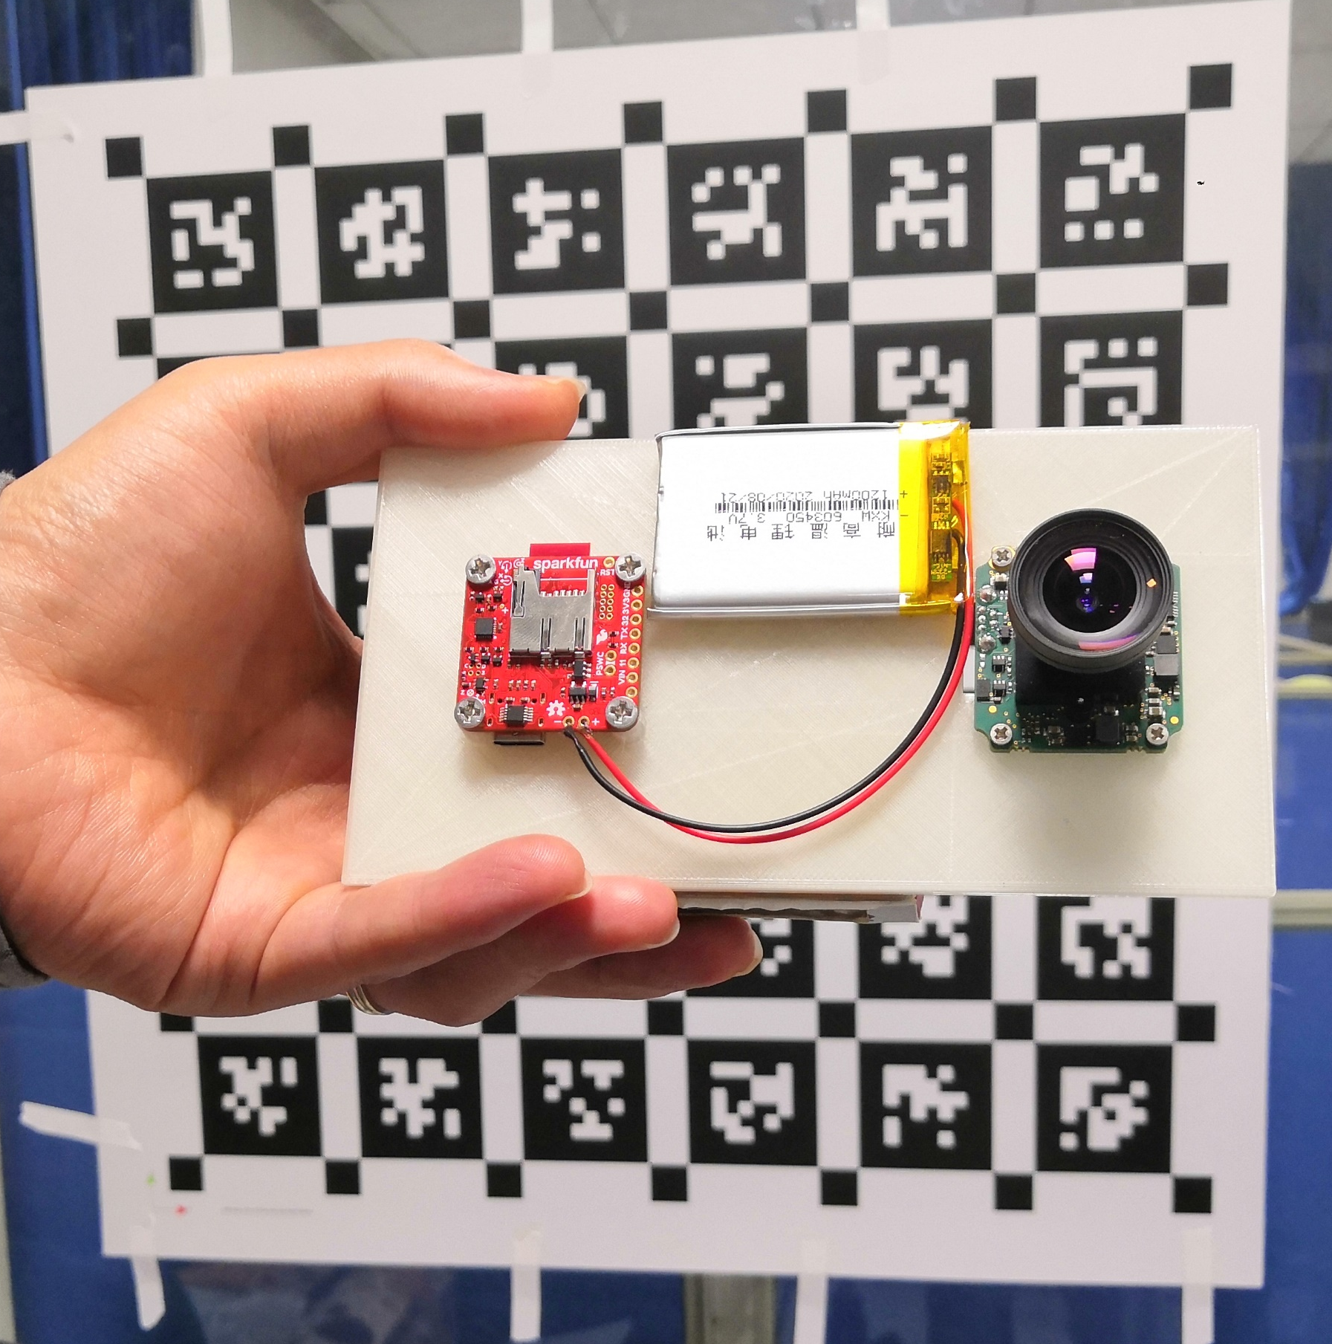
Bluefox artemis IMG_20210224_202628

Slide 4
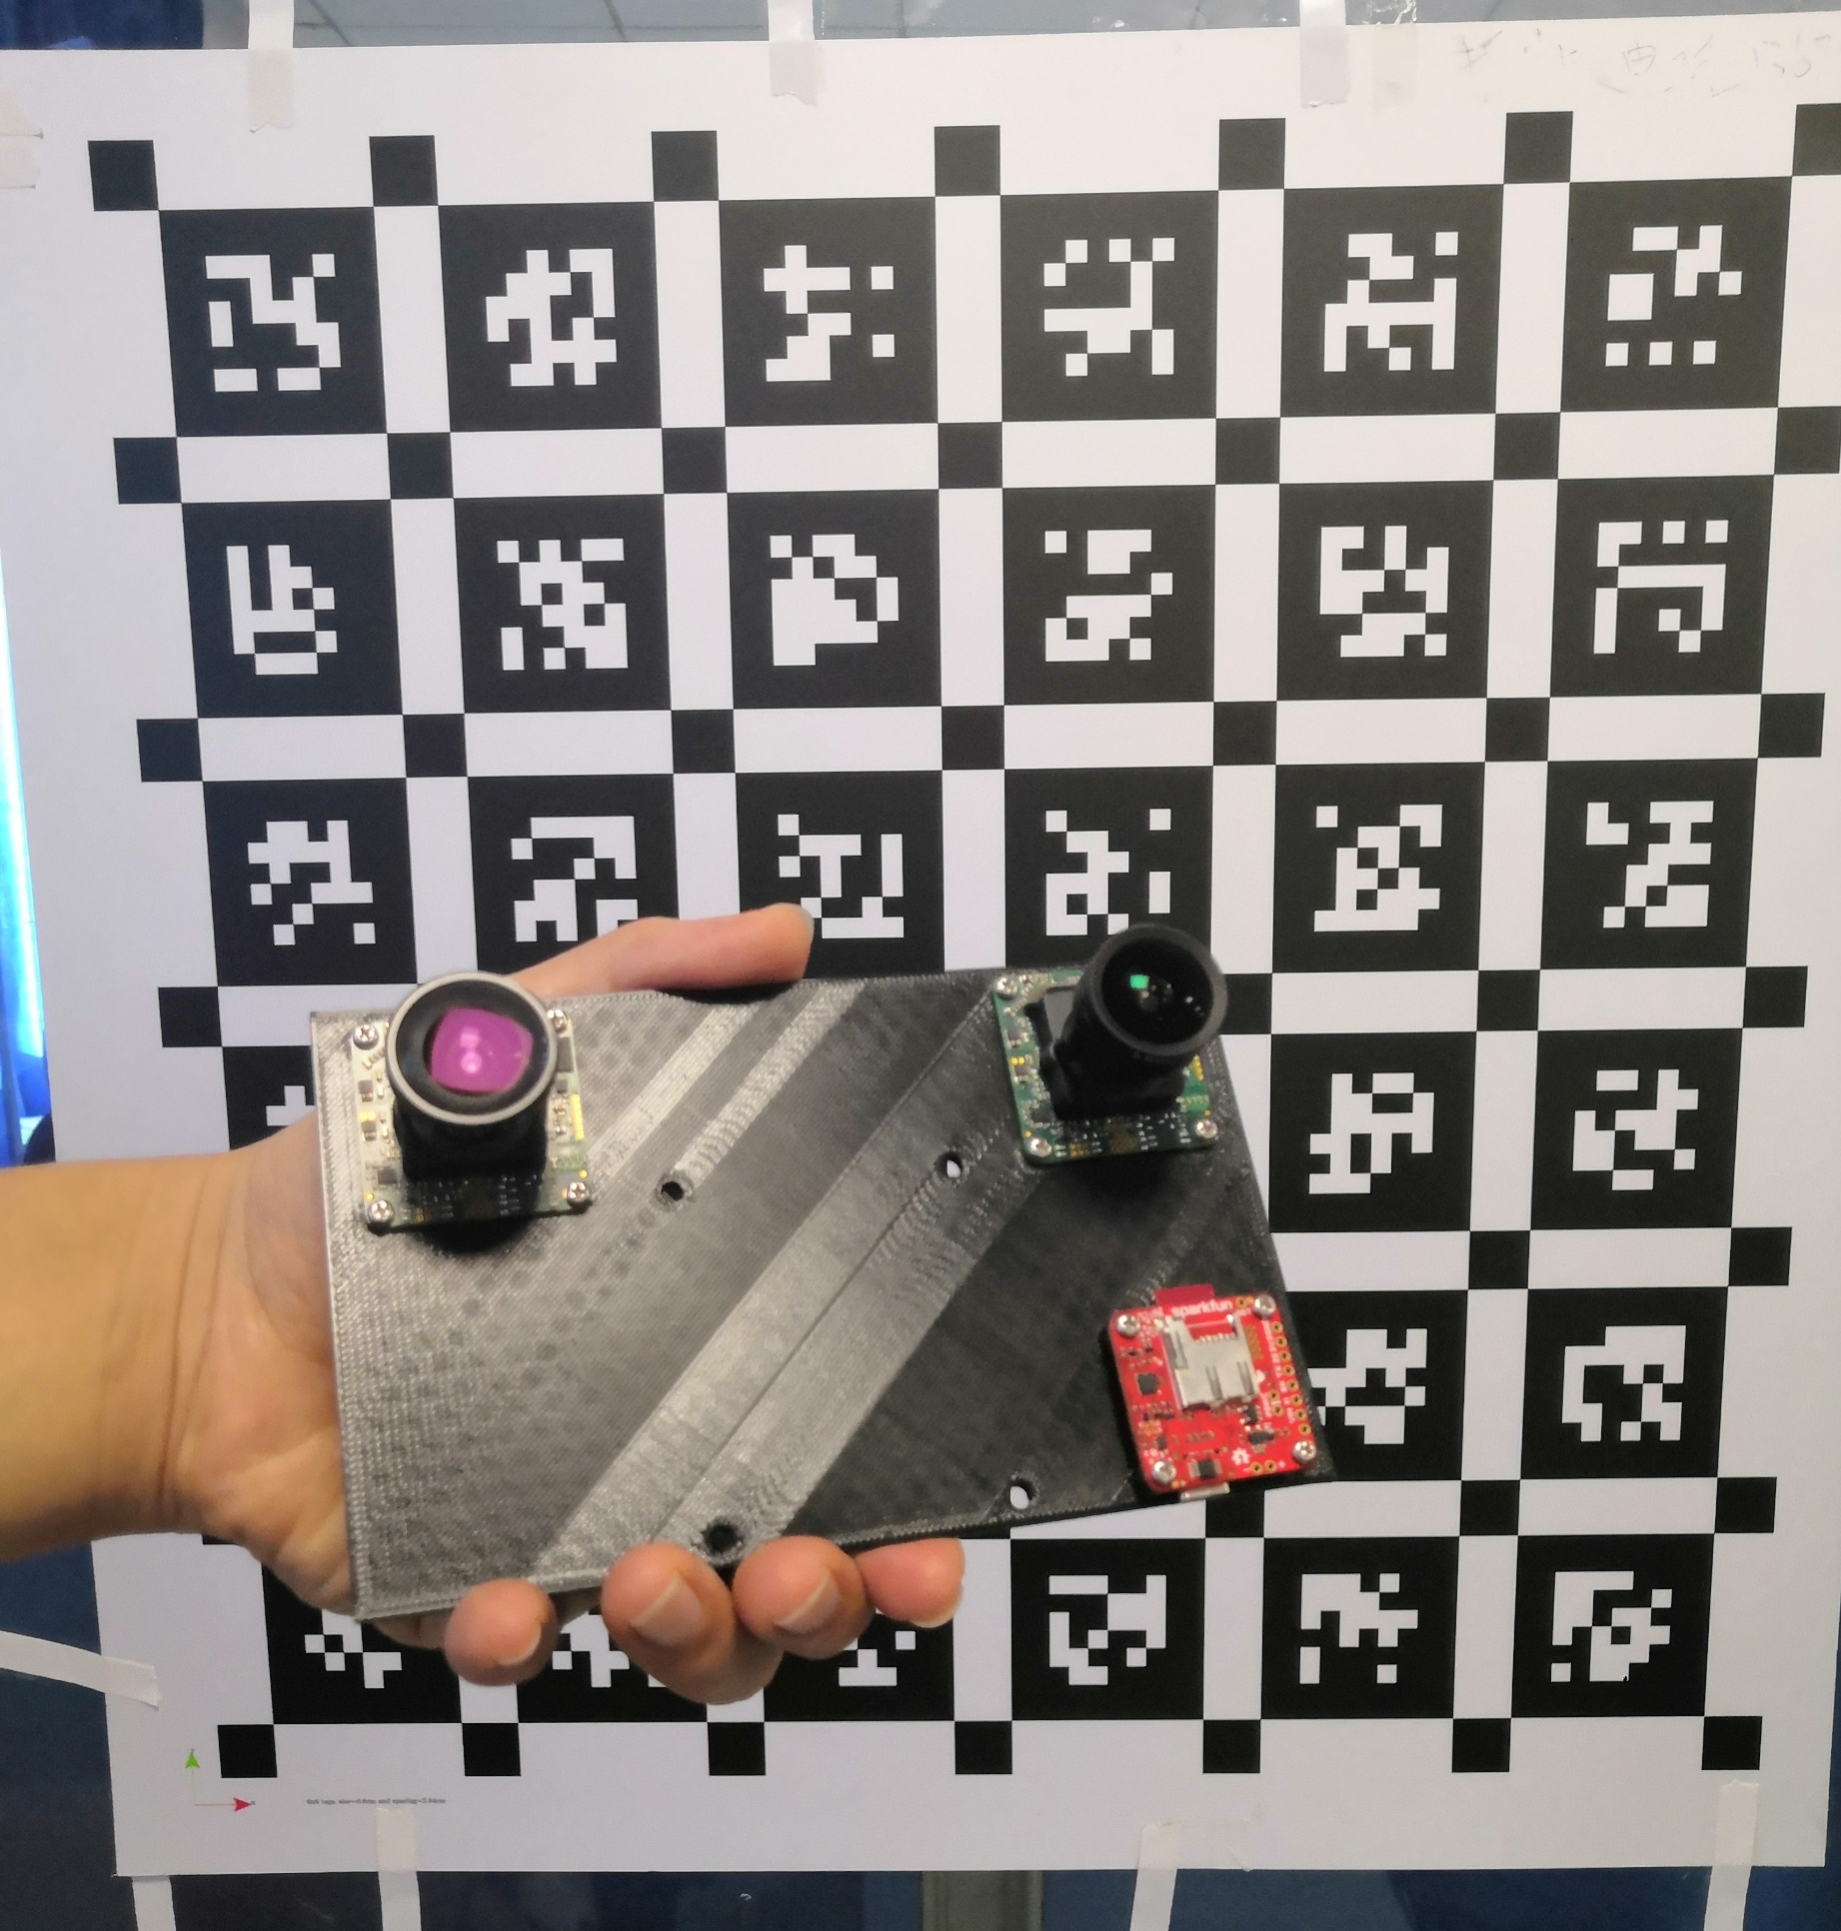
IMG_20210508_173317

